Slide 1

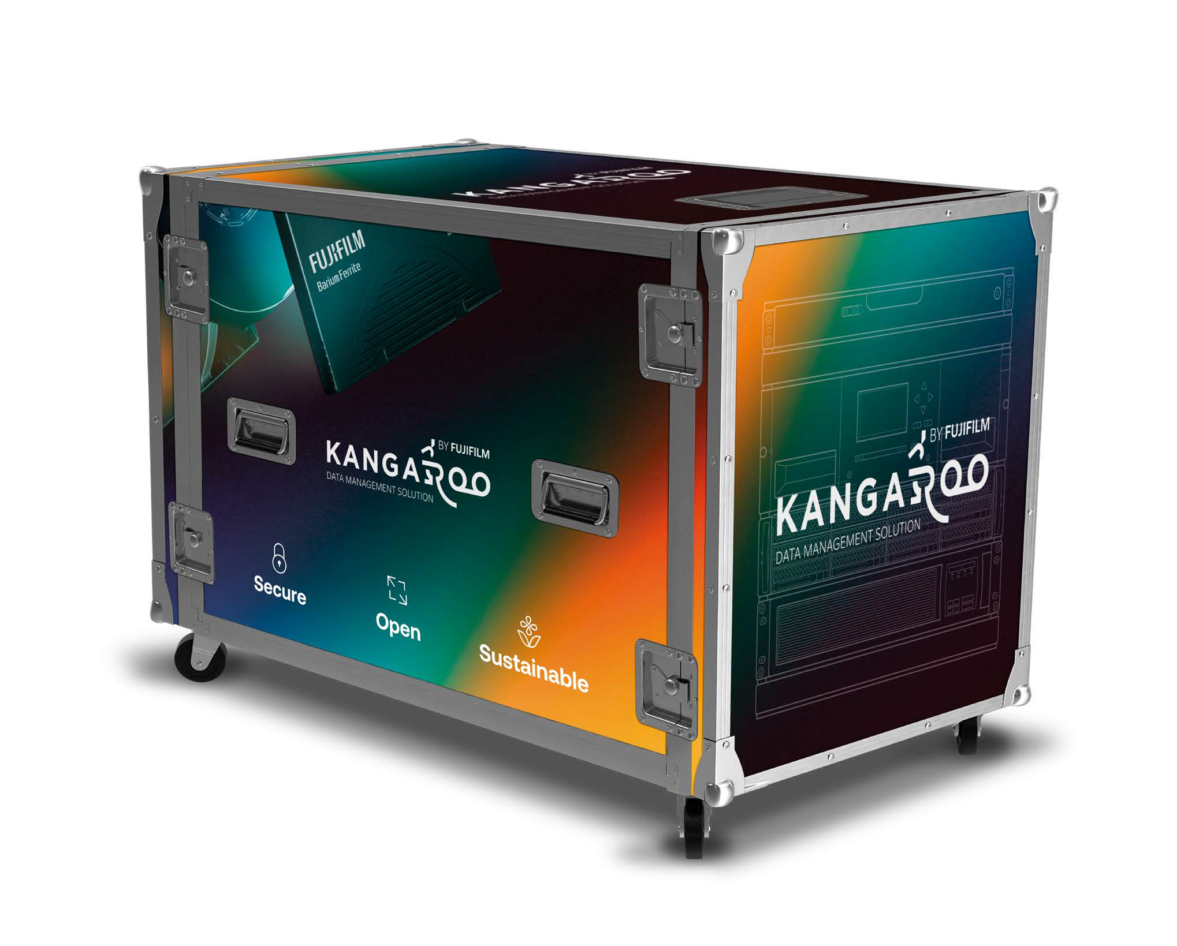


FUJIFILM Kangaroo
Plug and Play long-term data archiving solution
Hardware, software and tape included.
All components pre-installed.
FUJIFILM Object Archive Software
Reliable LTO-Tape Technology
1PB+ Storage Capacity

Slide 2

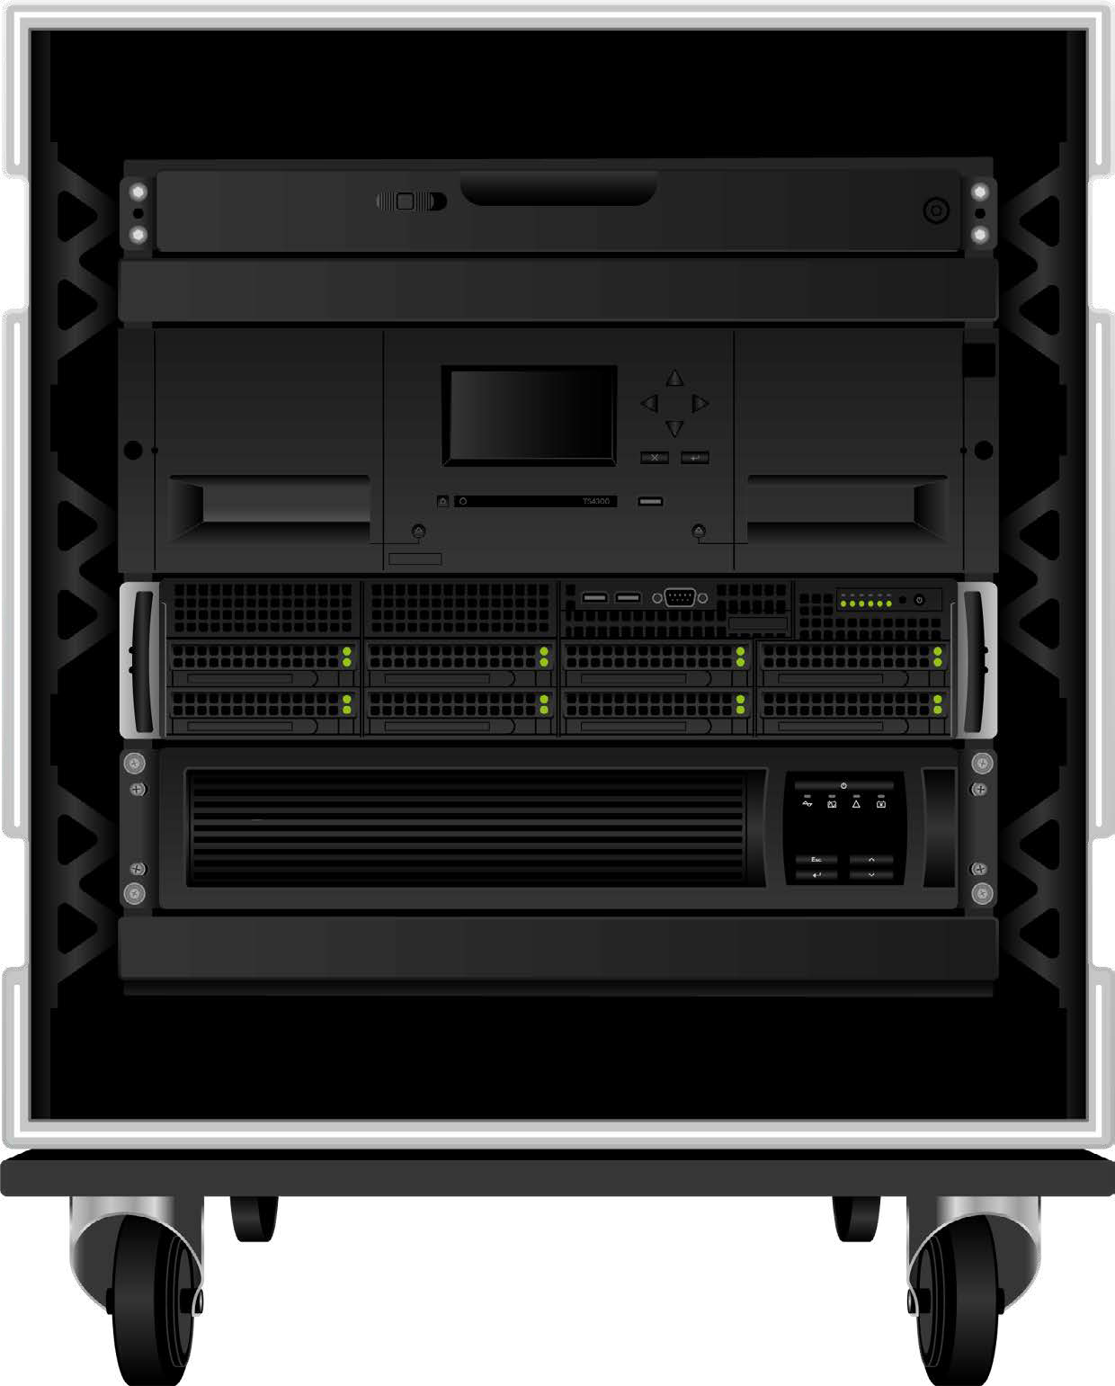


FUJIFILM Kangaroo
Turn-Key Ready - All Components Pre-Installed
Monitor and keyboard
Tape Library and LTO tapes
Server incl.
FUJIFILM Object Archive Software
UPS

Slide 3


Key Benefits of FUJIFILM Kangaroo
Secure
→ All security advantages from LTO-Tape Technology
Higher data integrity
Longevity of 30 years plus.
Reduced vulnerability to hackers and cyber-attacks due to the air-gap.
→ Future-proof advantages from FUJIFILM Object Archive software
Self-healing system architecture
ISO 27001 certified
Open
→ Self-describing system
→ No vendor lock-in
→ Compatible with various disk and tape systems
Sustainable
→ Tape based system is an eco-friendly choice for data archiving
→ Reduced energy costs, CO2-emissions and electronic waste
Flexible
→ Accumulates data from different sources (NFS, SMB, S3)
→ Access date via S3 providing flexibility in everyday approach
On Premise
→ Saves data on the go. An ideal solution for archiving on location or for limited floorspace.
Plug and Play
→ Ready to go and tailor made for the customer
→ Hardware, software and tape media pre-installed

Slide 4

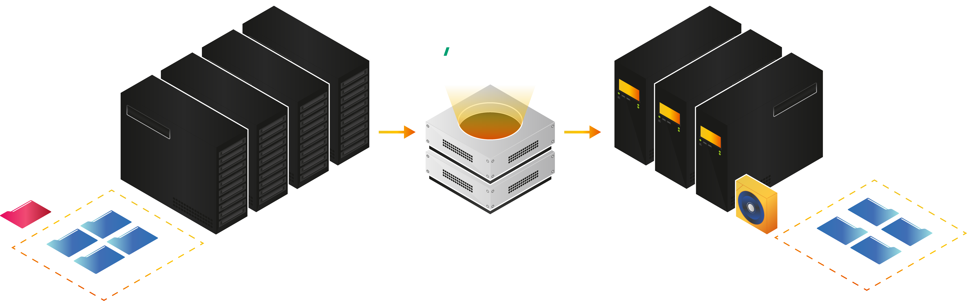
Workflow Examples
Cold Data Archiving
FUJIFILM Object Archive allows you
to create and manage an archive
to free up valuable space on
expensive primary storage.

Slide 5

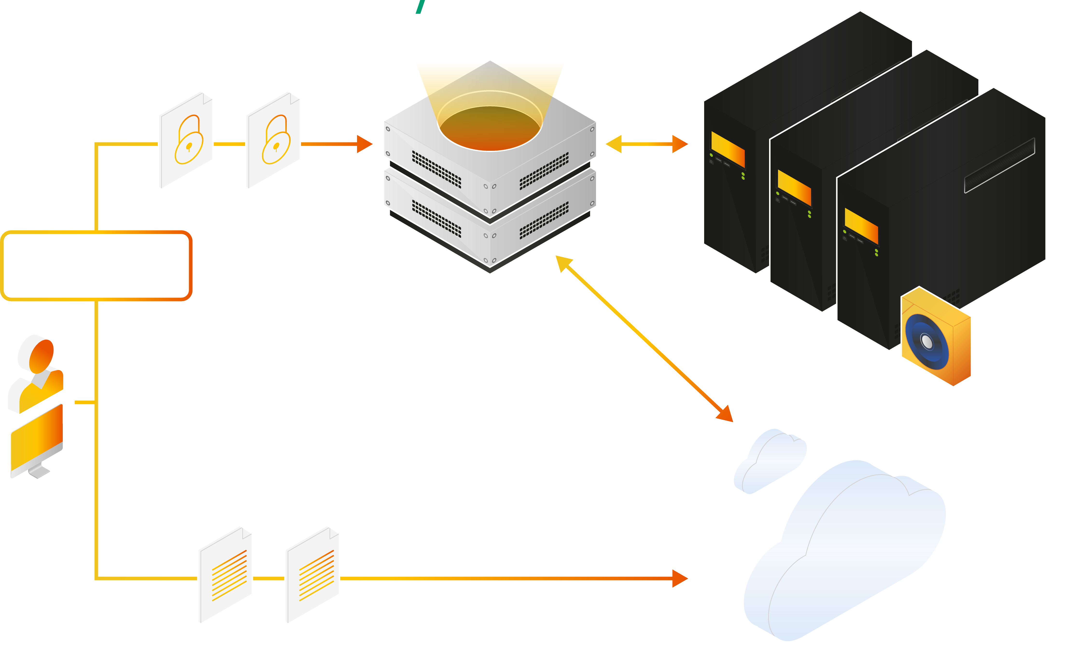
Workflow Scenario
Hybrid Cloud Storage
Tape storage is effective and performs better for storing mission-critical data that cannot be stored in a cloud environment, or for storing large amounts of data that would be more expensive to store in the cloud.

Slide 6
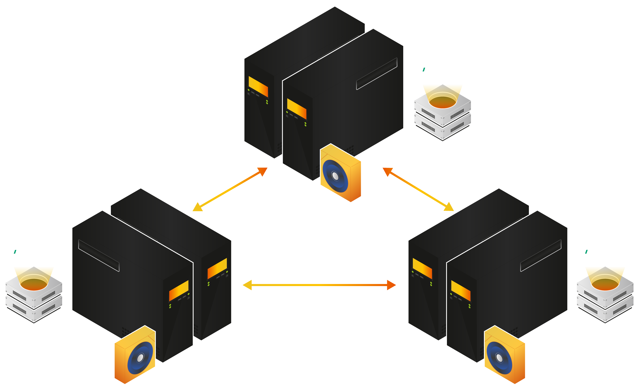
Workflow Scenario
Unified Tape Infrastructure
Using transport tapes to establish a unified tape infrastructure improves data accessibility, making it an essential component of enterprise data storage strategies. In this way, FUJIFILM Kangaroo helps reduce operational complexity and reduce maintenance costs by consolidating tape resources under a unified management software. This infrastructure ensures high-performance data retrieval, efficient data storage and enables easier scalability and improved data management.

Slide 7

Hardware Models
 |  | Kangaroo 'S' | Kangaroo 'M' | Kangaroo 'L'
Server | Basic Spec | CPU: 1 x 16 Core, RAM: 8x 16 GB DDR5 OS Storage: 2x 1.6 TB NVMe
 | Internal Storage | - | 38.4TB | 38.4TB
 | Raid Controller | RAID 1 | RAID 1, 6 | RAID 1, 6
 | PSU | Redundant
Tape Library | Tape Library | 1 Baseframe + 2 Expansion Frames
Tape Library | No. of Tape Library Drives | 2 x L9 | 2 x L9 | 4 x L9
 | Tape Media | 120 x LTO 9 + 2 LTOCN
Miscellaneous |  | UPS 3 kvA Rackmount, KVM Console, 230V 10 C13 PDU
Case |  | 19" Rack 100 cm Flight Case
Service |  | 9 x 5 NBD SW Support NBD + HDD retention HW Support (by manufacturer)
 | Price

Slide 8
Why FUJIFILM
World’s number one Tape manufacturer
Only manufacturer to have their own brand – guaranteed quality
Technical Support
Technical expertise and market intelligence
Marketing collateral
Joint sales and marketing activities
We already have the technology to produce tape into the next decade
True partnership!

